Slide 1
Benefits of Additive Manufacturing
Tim Schniepp – Additive Manufacturing Director
Timothy.Schniepp@barry-wehmiller.com
Additivemanufacturing@barry-wehmiller.com

Slide 2
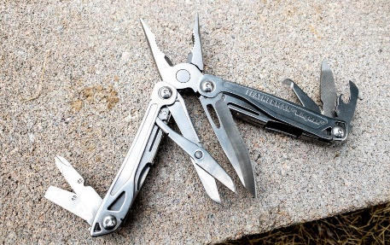
Benefits – Why use Additive Manufacturing?
The list of benefits is too long to list!
Primary High-Level Benefits include:
Versatile Tool to Solve Problems
Get Better Products to Market, Faster
Enable On-Demand Digital Manufacturing
Enhance Operations
Improve Customer Responsiveness
Immediate Benefits:
Future Potential:
Design Freedom
On-Demand Mfg
Iterate quickly
Reduce inventory
Part count reduction
Improve Operations
Save time & money
Sustainability

Slide 3
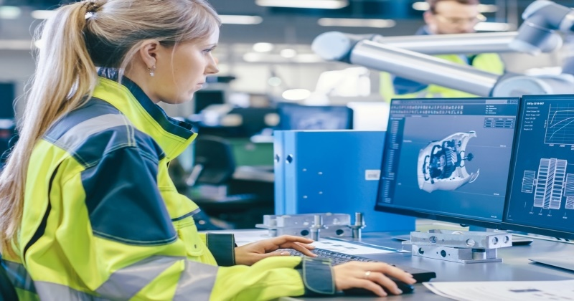
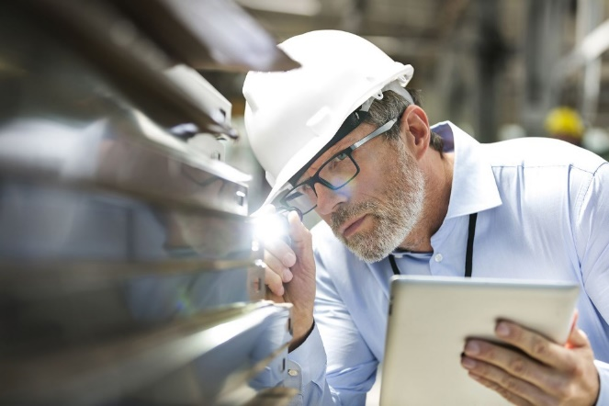
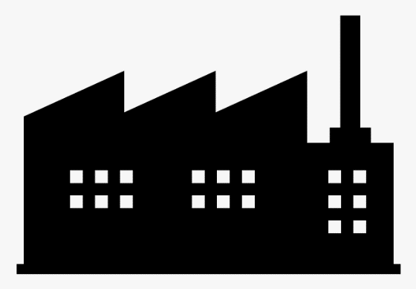
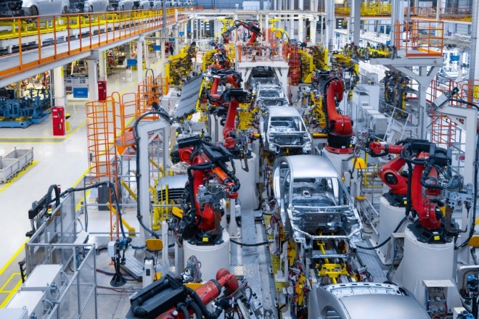
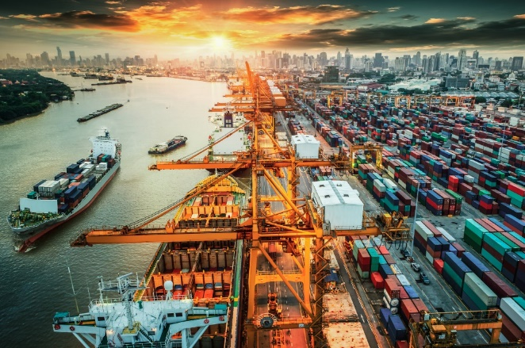
Where is AM used within organizations?
Target audience – engineers, engineering leaders, development teams, cost reduction efforts
Who should care?
Innovate
Iterate
Verify concepts
Simplify
Improve
Verify specs
Design & Development
Quality Assurance
Manufacturing & Operations
Efficiency
Safety
Reduce Scrap
On Demand
Distributed
Zero Inventory
Supply Chain / Aftermarket

Slide 4
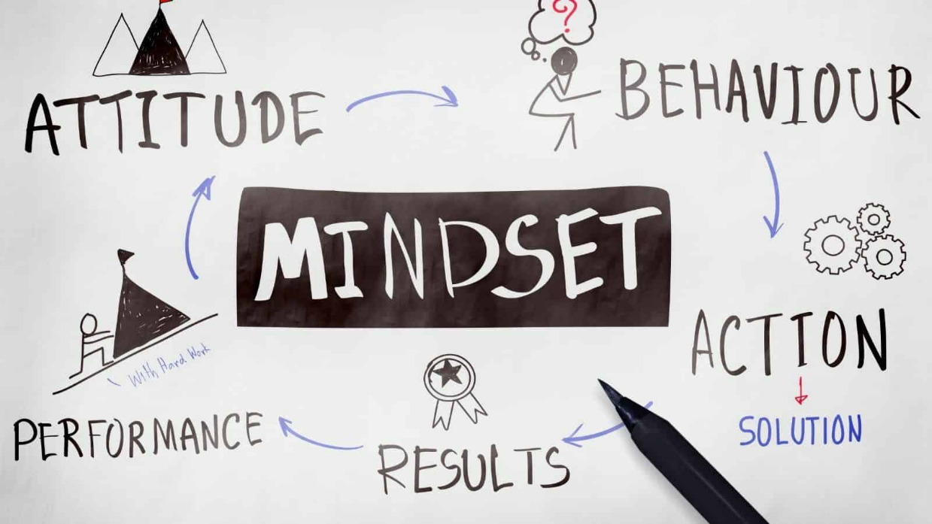
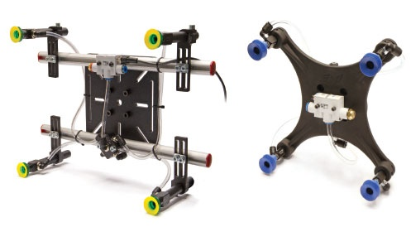
Why Additive Manufacturing?
→ Which design is “better”?
Design for function
Solve problems
On-demand (aftermarket) parts
→ Which design is “better” for BW!?

Slide 5
Comparison – Why Additive Manufacturing?
Customer Benefit Mutual BW Benefit
Designed specifically for the application (performance)
Lightweight (reduce cycle-time & wear, easier handling)
Produced on-demand with near-zero lead time
Easily identified (printed part numbers & branding)
Easy to modify designs, customizable
Improved aesthetics (“elegant” solutions)
BW-owned IP
Novel design that can only be sourced through BW
Reduced part count, simplified sourcing, reduced lead time
Opportunity for significant cost savings via part consolidation
Difficult to reverse engineer / replicate
Familiar, low risk, comfortable/proven
Widely available components
Somewhat modular, potentially adjustable
Well-known design guidelines (global standards)
Predictable performance
Utilizes off-the-shelf components – design for cost
Both design approaches are valid technically → 3DP is often “best” for BW (and our customers!)

Slide 6
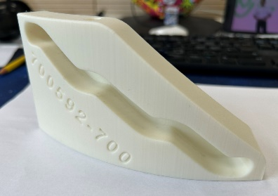
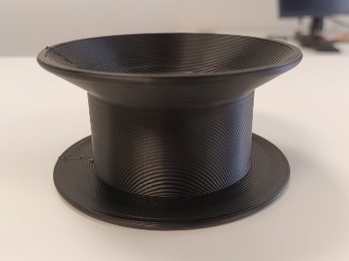
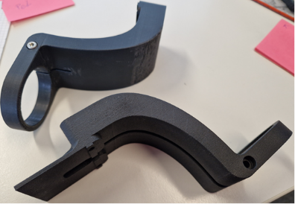
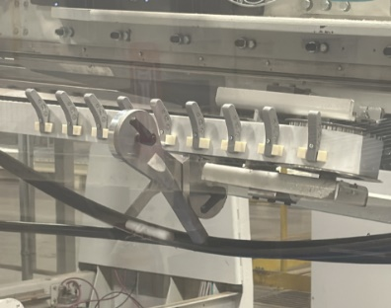
Impact – Beyond Stuttgart
Converting
Packaging
Change Parts
Multiple orders of production parts already printed at AMC-Stuttgart and in GB
Transferring dozens of printed parts from GB to AMC-Clearwater (>$100K savings)
Hosting new AMC in Clearwater
Production parts being printed in Waterloo
First AMC-Stuttgart printed parts validated for Doncaster
$15K annual savings
Thread-Up Pulleys
Papersystems
MSI
Camera Bracket
Printed three orders of 100+ parts each for HV in Clearwater – saving tens of thousands on new mold costs
Additional parts now in-work
First local training conducted in June
Printed parts “on every machine” produced at MSI-Intec
First BW-TEC parts printed at AMC-Stuttgart
Folding Keys

Slide 7
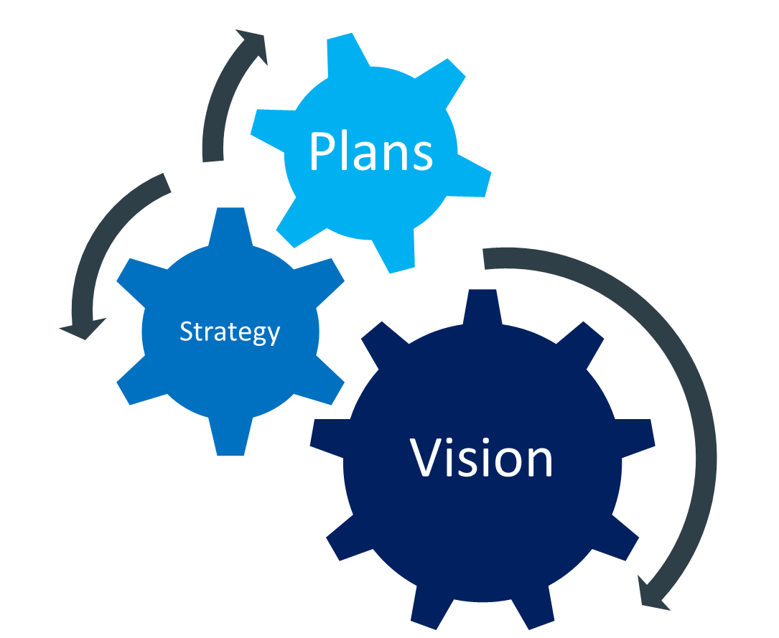
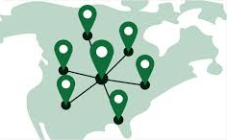
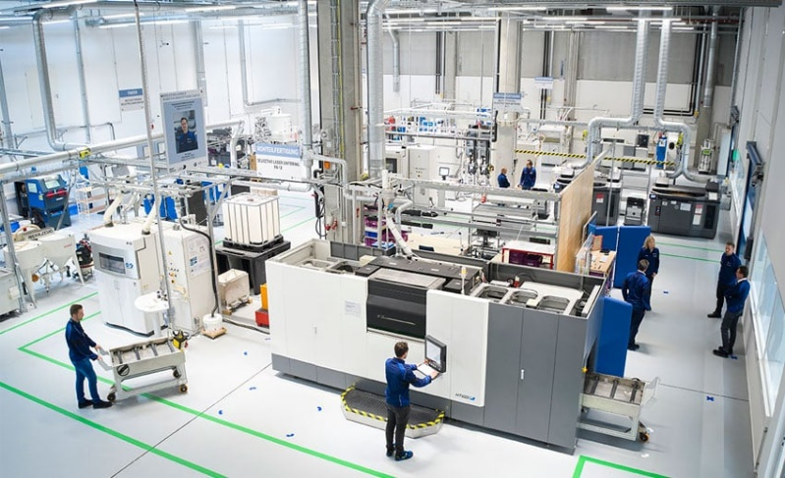
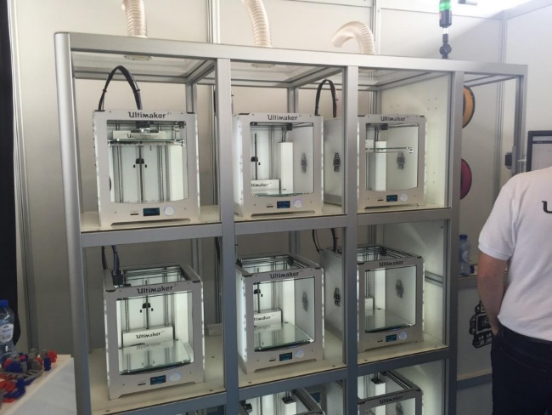
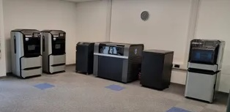
BW Vision & Strategy
Provide easy access and support to enabling capabilities to solve problems, design for performance, and ultimately enable distributed manufacturing for aftermarket parts
High Level Strategy
Additive Centers in US & Europe + small technical teams to support
Hub & Spoke model
(Centers w/ industrial tech) (connected digitally + deployable low-cost printers)
Concept
Reality
Notes:
Hubs provide production capabilities…the “spoke” portion refers to local deployment of low cost printers for training, prototyping, and experimentation.
Key internal VoC – engineering is now being asked to operate the printers, which is fine for development, but not realistic for production.

Slide 8
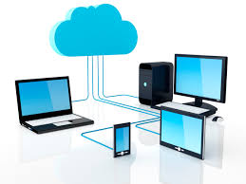
Planned Additive Manufacturing Centers (AMC)
AMC-Stuttgart
Neuwied
BW-TEC
Lucca
Doncaster, Manchester, Nottingham
Paris, Terneuzen, Mestrino, etc.
Hamburg
Stuttgart
AMC-Clearwater
Waterloo
Flagstaff
Tuscon
Spokane
Green Bay
Phillips
Loveland, Romeoville, Baltimore, Akron, Etc.
Minneapolis
Clearwater
Shared Order & Workflow Management System
Two Centers to support our primary regions of operation
Notes:
Proposed Approach
Two Additive Hubs – Stuttgart Germany, Clearwater FL
FDM technology focus while evaluating others – Christian will elaborate more on why
Supported by small dedicated teams (1 engineer, 1 technician per center)
AMC-Stuttgart is operational and opening up / AMC-Clearwater is next
The hubs are the execution component…the design can and will happen anywhere.

Slide 9
Why In-House?
Generate and Protect IP – Accelerated
Novel designs and functionality
Benefit Now
Flexible, design-for-function/performance
Save time and cost
Avoid supply chain issues
And into the Future…
Flexible, design-for-function/performance
Novel designs, sourced only through BW
Produced on-demand, near-zero lead time
License 3D models for customer printing
Due to the relative immaturity of the supply chain for additive manufacturing, vertical integration makes sense for BW
Quality standards are not universal – in-house manufacturing gives us control and assurance
Not a commodity – additive manufacturing is still a high margin business for external providers
In-house production will save >25% additional cost vs. outsourced 3DP parts
With 3DP, designs are valuable IP and warrant protection
Complete control over production schedules – allows on-demand manufacturing of priority spare parts, as needed
Internal availability drives utilization and accelerated learning
In-house will help us do more, do it faster, and save more while ensuring quality
Notes:
Plenty of external vendors, but…Numerous advantages to bringing these capabilities in-house.
-Take advantage and learn more quickly, iterate daily, accelerate adoption.
-But likely most importantly…gives us control over the parts we produce. Lesson learned – we’ve seen variability, this helps us reduce it.
-Primarily bring extrusion-based AM tech in-house, outsource others as we build a case to invest (where it makes sense).

Slide 10
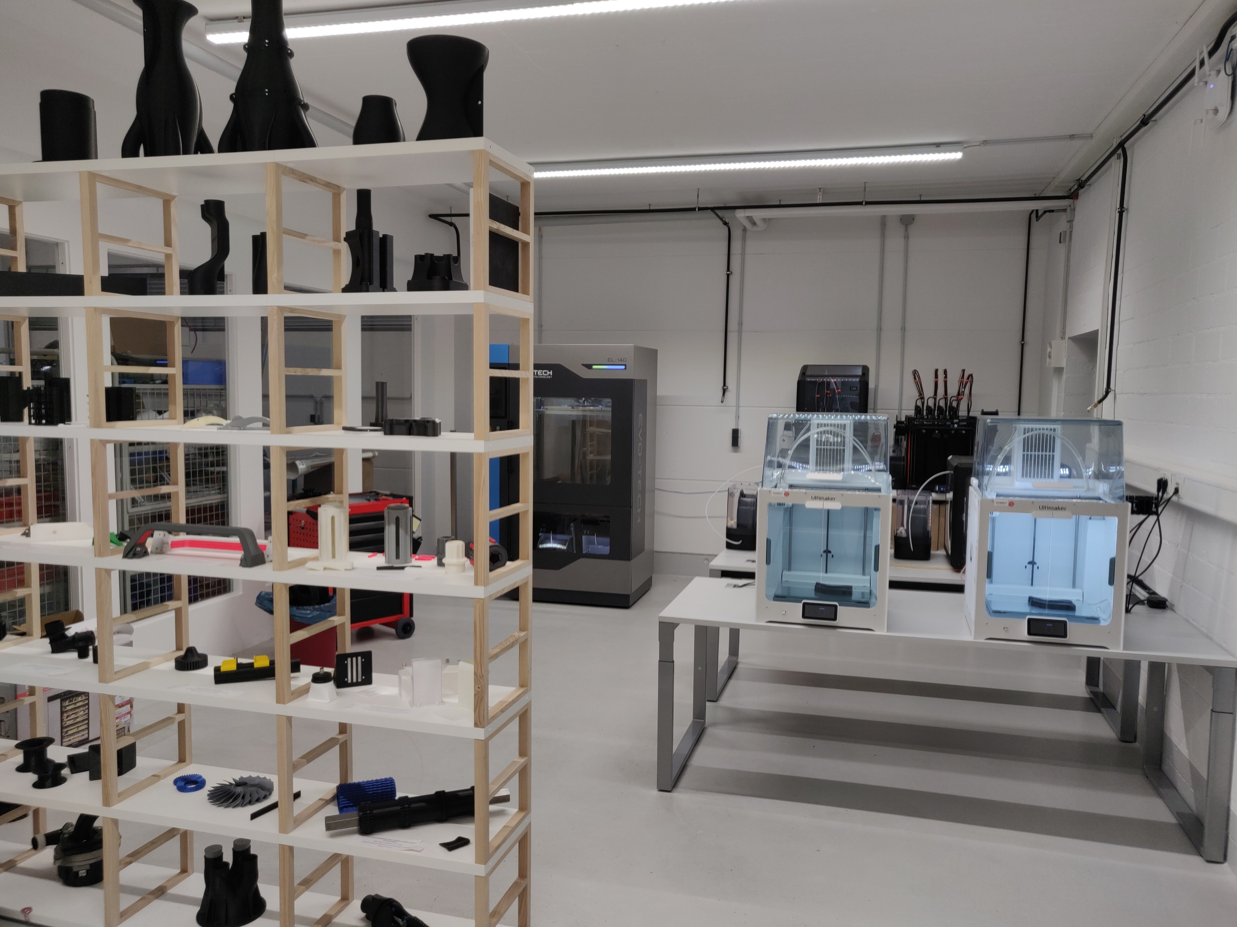
Keys to Success – AMC-Stuttgart & AMC-Clearwater
Internal AMC utilization is vital to our success
Provides expertise & experience
Standards – Quality – Reduced Variability
Industrial Capabilities + Capacity (scale)
Why use the AMC?
Validate, then expand access & capabilities
High utilization = lowest possible cost
Consistent material, process, and design standards
US Center now available as well – enables consistent global production

Slide 11
BW Examples

Slide 12
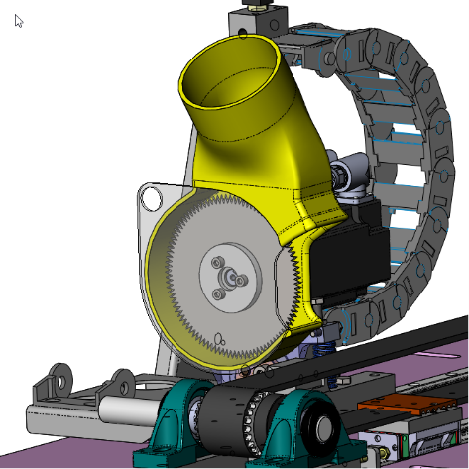
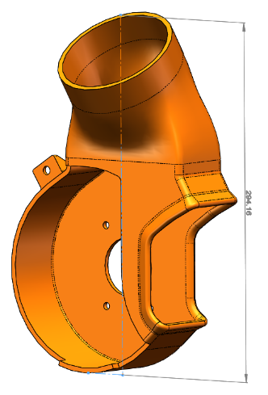
Use Case Example & Impact
Dust Cover Housing / Saw Blade Guard
Originally Planned Multi-Piece Sheet Metal Design
Cost >$1200 for complete assembly
Lead time – 6-8 weeks, minimum
3D Printing – Back of the envelope ROI
Internal 3DP cost = < $200 / Sheet metal cost = $1000 20-30 parts/yr – projected demand
Savings = $800/part @ 25 parts/yr = $20K / year
294 mm

Slide 13
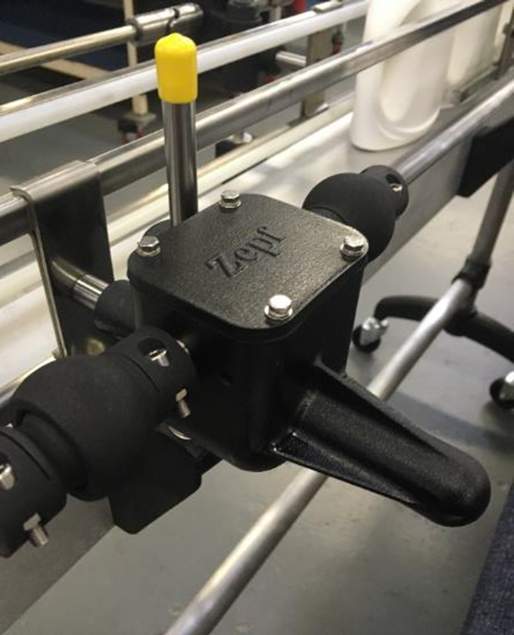
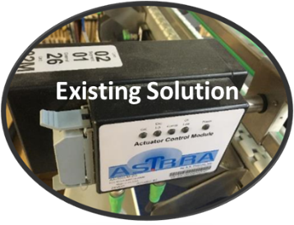
Functional Prototyping
The PSA Zepf team had concepts in mind to improve guide rail performance, but were limited by costly off-the-shelf gearbox components.
They turned to 3D printing to produce and validate concepts through functional prototyping. Components were produced in days and the final design was validated in just weeks. Production parts were then produced with injection molded components for additional cost savings.
Final product cost savings of 65% ($350 vs. $1000)
Lead time reduced by >75%
Part count (and supplier) reduction of >75%
Lightweight, improved performance, simplified installation
Notes:
Develop, evaluate, and iterate
Lightweight, improved performance, easier installation
Simplify – reduce part count, complexity, suppliers
Added value – branding, part info
Try new things, validate, improve
Validated in 3DP, produced via injection molding
Cost savings – $350 vs. $1000

Slide 14
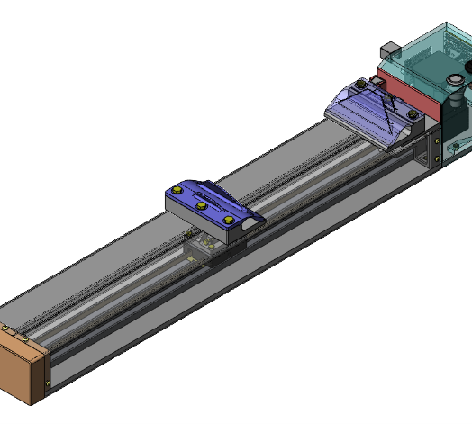
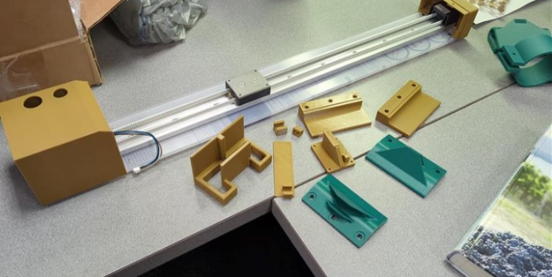
Process Improvement – Manufacturing Aids, Tooling, Test Equipment
The PCMC team often relies on deep institutional knowledge and experience to ensure product performance, but lacked quantitative data. Custom test equipment costs had been prohibitive in deepening process understanding.
They turned to in-house 3D printing capabilities to produce test equipment components to evaluate interlaminar bond strength in tissue products. 3DP permitted quick iteration and custom approaches, in a cost effective manner.
Custom test equipment to evaluate and improve products
Deeper understanding and quantitative data on product performance
Immeasurable potential cost savings through future process improvement
Notes:
Develop, evaluate, and iterate
Lightweight, improved performance, easier installation
Simplify – reduce part count, complexity, suppliers
Added value – branding, part info
Try new things, validate, improve
Validated in 3DP, produced via injection molding
Cost savings – $350 vs. $1000

Slide 15
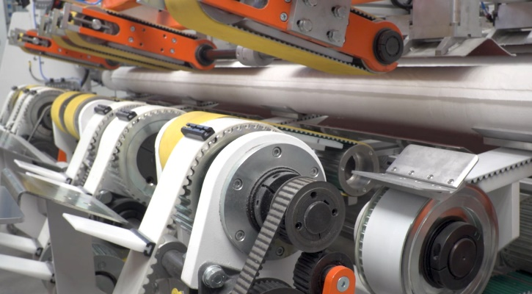
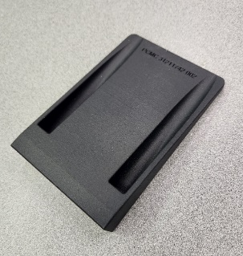
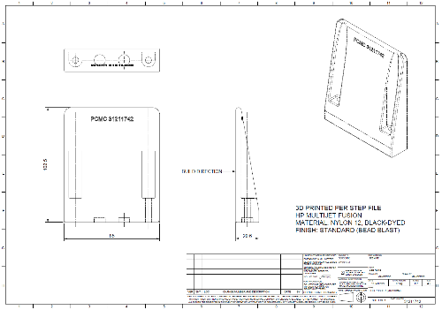
Production Parts
The PCMC team required cost-effective solutions for a range of non-metallic components – paddles, carriers, etc. – for a new mandrel extractor in development. Moreover, the parts would be designed in Wisconsin and produced in Lucca, Italy, which created potential sourcing challenges.
Additive Manufacturing is ideally suited to enable on-demand, distributed manufacturing, i.e., produce what you want, where you want it. The parts could easily be designed in Green Bay, specifying key parameters on the drawing, and printed by local vendors in Lucca.
Up to 80% part cost savings, no molds or machining
Lead times of just days
Can be printed anywhere in the world on-demand, eliminating inventory costs and simplifying sourcing
Additional value-added (branding, part numbers, alignment features)

Slide 16
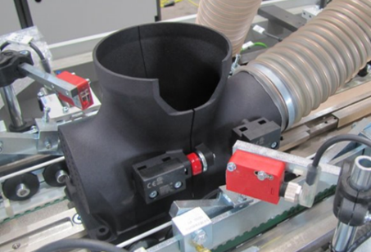
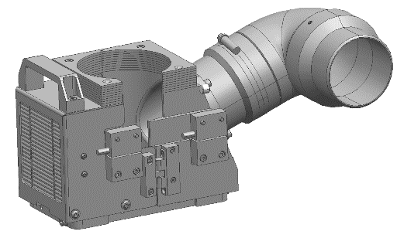
Production Parts
Laser engraving creates smoke that is a safety issue for customers. Conventional designs for smoke evacuation chambers consisted of more than 90 individual components and existing designs did not perform well due to poor air flow and frequent smoke leaks at gaps between assembled components.
A primary benefit of additive manufacturing is the ability to consolidate parts. The Papersystems team took advantage of the design freedom of 3DP to drastically reduce part count, eliminate tedious assembly operations, and produce a design with greater performance (improved aerodynamics and air flow, eliminated potential for leaks).
>40% cost reduction (€800 / assembly savings)
>95% part count reduction (from 92 to 2) / no sourcing, 3DP on demand
>95% assembly time reduction (from 3 hours to 5 minutes)
Safer and improved performance – no leaks, reduced noise, better air flow
Custom, unique, high value part

Slide 17
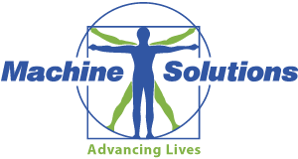
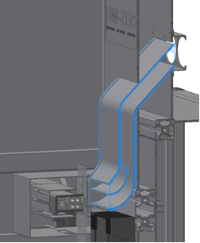
Production Parts
BW-TEC in Switzerland (MSI) upgraded an existing machine design to include a hot air knife, which in turn required ducting to vent used air. To fit the existing space within the machine, a metal part design required multiple machined and sheet metal components and many hours of touch labor and assembly.
The team shifted their approach to utilize additive manufacturing, which easily permitted a single-piece design while providing the design freedom to fit the tight space perfectly and maximize performance. The part is printed on-demand and sourced in a matter of days even while using external vendors.
70% cost savings ($330/part vs. >$1100 for sheet metal assy)
Printed as a single part vs. multiple assembled components
Eliminated hours of hand labor and assembly
Performing well since 2015 in 30+ machines

Slide 18
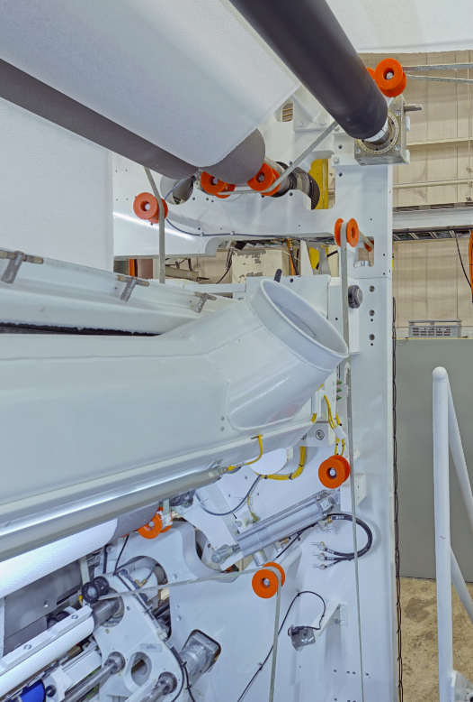
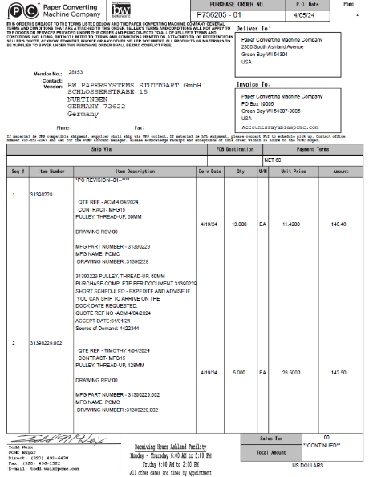
First AMC-Stuttgart Order for Converting – May ‘24
Thread-Up Pulleys (parts in orange) replacement – 3 sizes
Used on all tissue converting lines (Lucca & Green Bay)
Part of a cost-reduction effort for ‘Unwind’ product lines
40-80% cost savings (depending on part size) → $15K savings/year
Initial order of 58 parts, > 110 print hours
Notes:
Milestone – first non-Stuttgart parts.
3 orders for Converting – 3 different part sizes, used across multiple product lines and continents – assembly in Lucca and GB

Slide 19
More Questions? Timothy.schniepp@barry-wehmiller.com additivemanufacturing@barry-wehmiller.com
Notes:
2 seconds

